Slide 1
Software Testing Overview
STLC
Types of Testing
Testing Terminologies
Ways of Testing
Defect Lifecycle

Slide 2
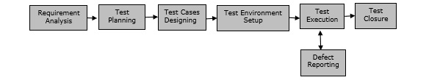
STLC
Requirement Analysis − When the SRD is ready and shared with the stakeholders, the testing team starts high level analysis concerning the AUT (Application under Test).
Test Planning − Test Team plans the strategy and approach.
Test Case Designing − Develop the test cases based on scope and criteria’s.
Test Environment Setup − When integrated environment is ready to validate the product.
Test Execution − Real-time validation of product and finding bugs.
Test Closure − Once testing is completed, matrix, reports, results are documented.

Slide 3
Types of Testing
Unit testing
Sanity testing
Functional testing
Integration testing
End to end testing
Regression testing
Non functional testing(Performance, Load, Stress)
User Acceptance testing(UAT)

Slide 4
Testing Terminologies
Assertion
An assertion is used in automated testing to assert the expected behavior of the test. An assertion fails if the result is different than what you expected it to be. This is a key concept in functional testing. Assertions are commonly used in Unit testing, but the same concept applies to other forms of automated tests.
Test case
A test case is the complete set of pre-requisites, required data, and expected outcomes for a given instance of a Test.
A test case is designed to pass or to fail. Often this depends on the data passed to the Test
Test Scenario
A sequence of activities performed in a system, such as logging in, signing up a customer, ordering products, and printing an invoice. You can combine test cases to form a scenario especially at higher test levels.
Test Suite
A Test Suite is a collection of test cases. In automated testing, it can mean a collection of test scripts.

Slide 5
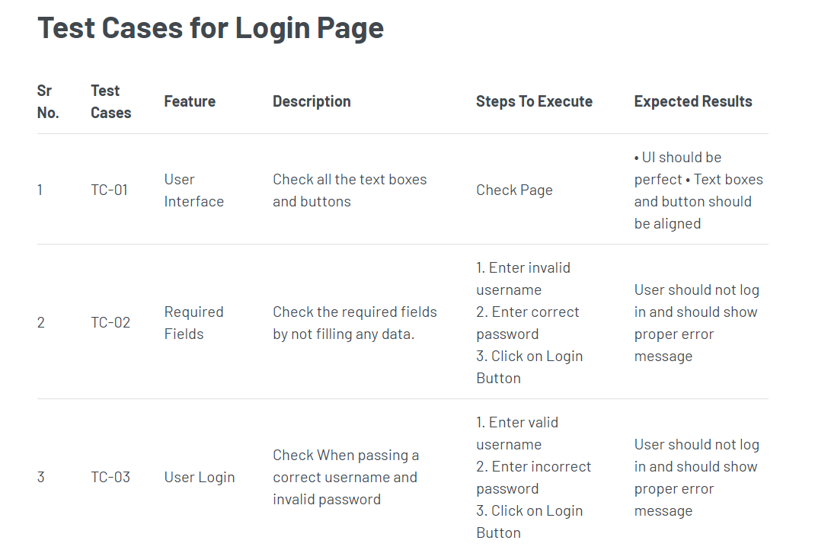
Ways of Testing
Manual Testing
Automation Testing

Slide 6
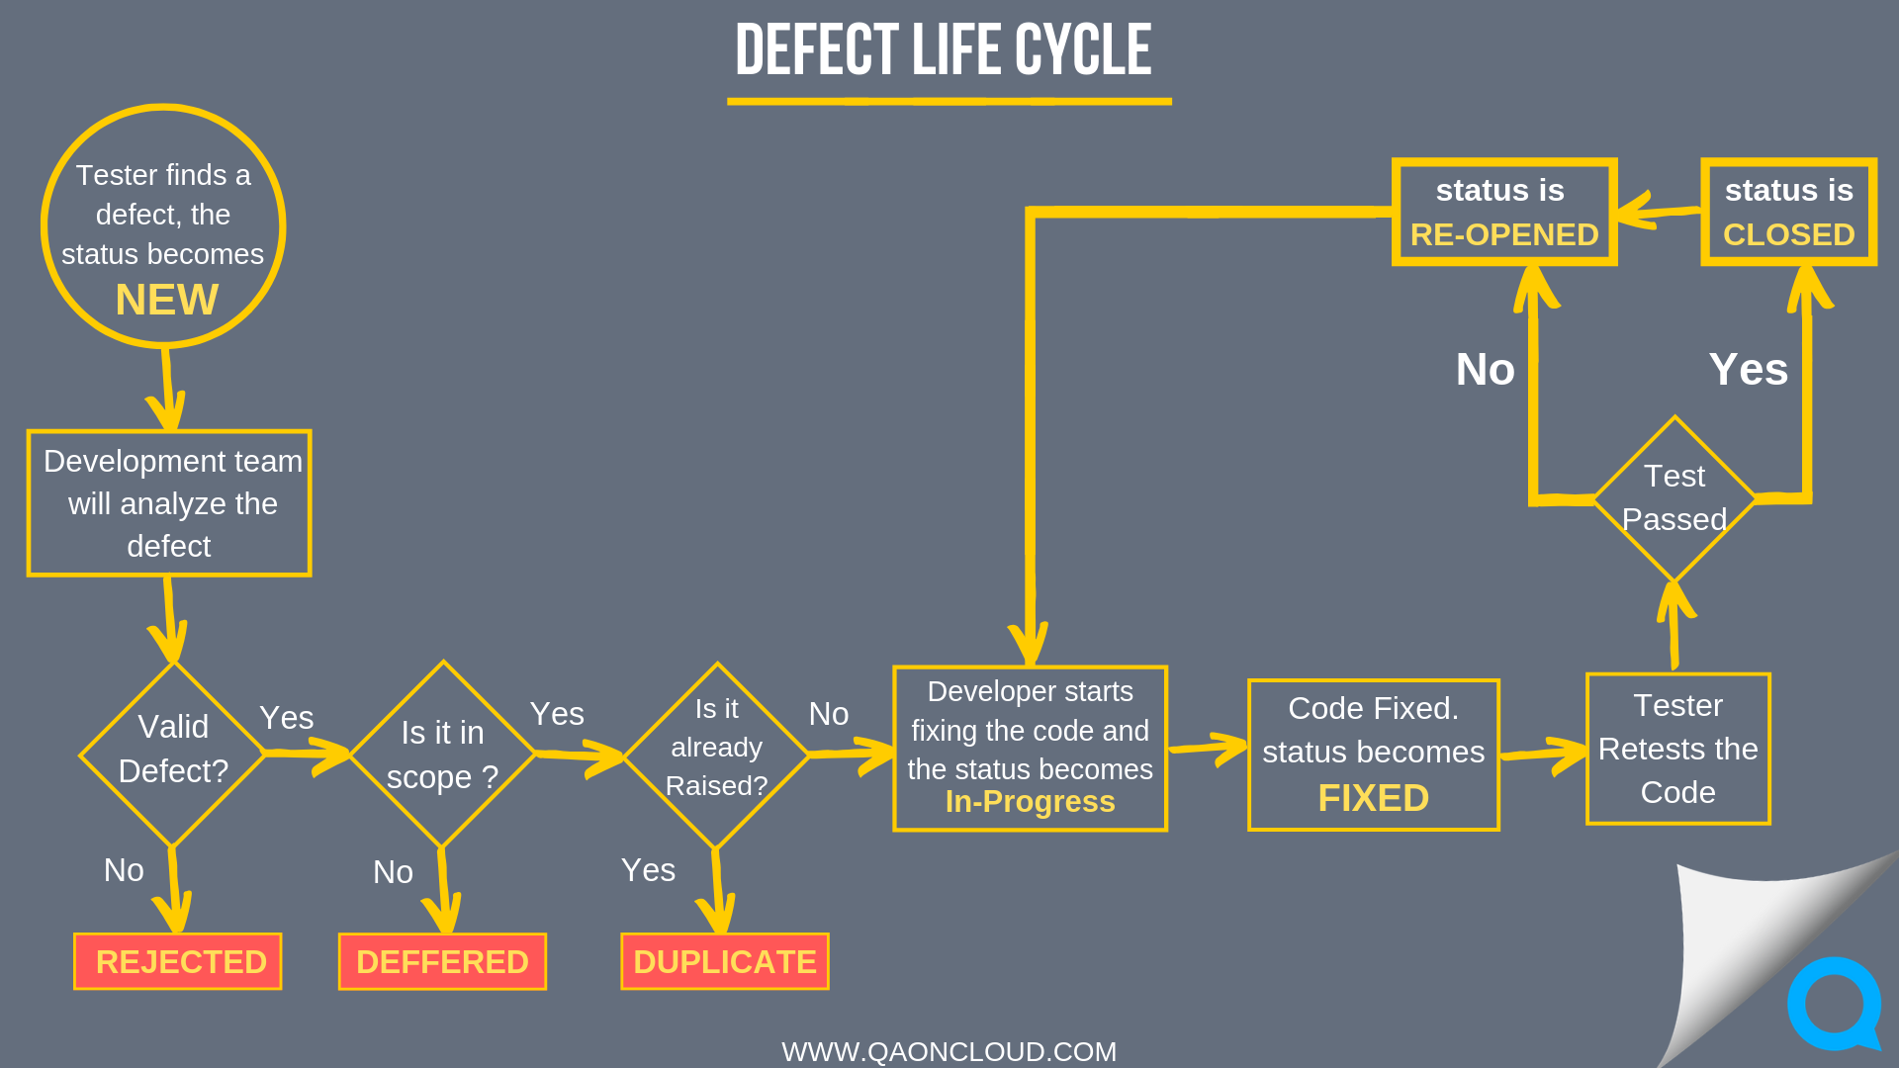
Defect Life Cycle

